Slide 1
Neural heterogeneity promotes robust learning
Nicolas Perez-Nieves, Vincent C. H. Leung, Pier Luigi Dragotti, Dan F. M. Goodman

Slide 2
Supplementary material

Slide 3
Model
Three layers of spiking neurons: an input layer, a recurrently connected layer (RNNs and biological NNs share several properties, such as a similar general architecture, temporal dynamics, and learning through weight adjustments [Neftci et al , 14]), and a readout layer used to generate predictions.
Heterogeneity was introduced by giving each neuron an individual membrane and synaptic time constant.
The first spike in the output layer will rapidly classify the input signal.

Slide 4
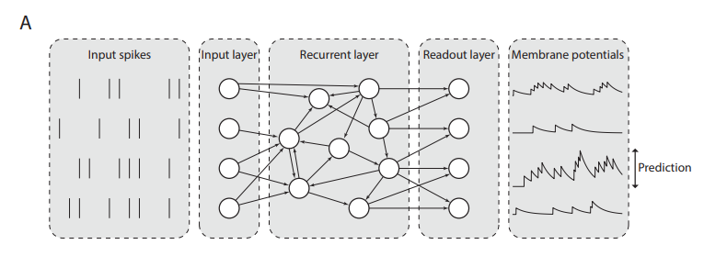
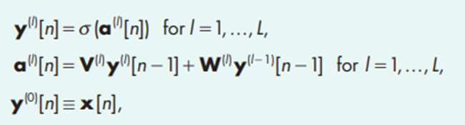
Model

Slide 5
Model
Cases that were studied:
Initial values could be either homogeneous (all synaptic and membrane time constants are initialized to the same value) or heterogeneous (synaptic and membrane time constants are randomly initialized for each neuron by sampling them from a given probability distribution (in this case, a gamma distribution))
Training could be either standard (only the synaptic weights are learned) or heterogeneous (the synaptic weights and membrane and synaptic time constants are learned).

Slide 6
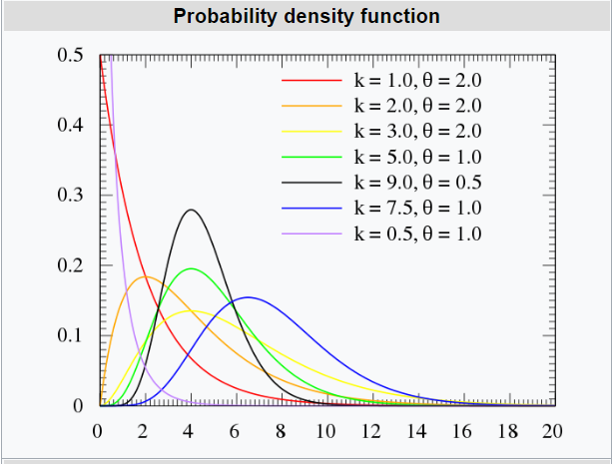

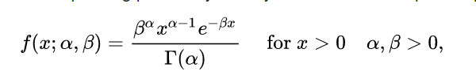
Gamma Distribution
α = k (shape) and β = 1/θ (rate)

Slide 7
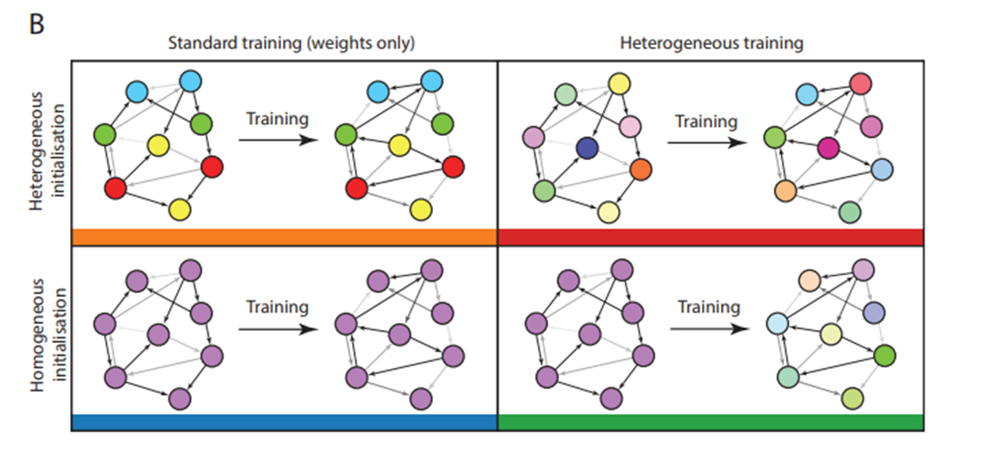
Model
Synaptic weights were plastic (changing during the training), but depending on the training method, the time constants were either held fixed at their initial values (standard training), or could be modified (heterogeneous training regime).

Slide 8
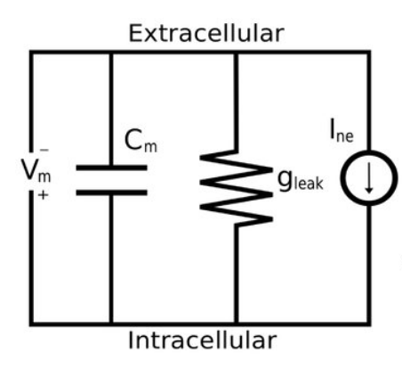

Model
Leaky Integrate and Fire (LIF) neuron model
(Neftci et al mentions I_{i}R, which is dimensionally correct)
τ_{m} is the membrane time constant, U₀ is the resting potential and I^{(l)}_{i} is the input current.
When membrane potential reaches the threshold value U_{th} a spike is emitted, U_{i}(t) resets to the reset potential Ur and then enters a refractory period that lasts t_{ref} seconds

Slide 9
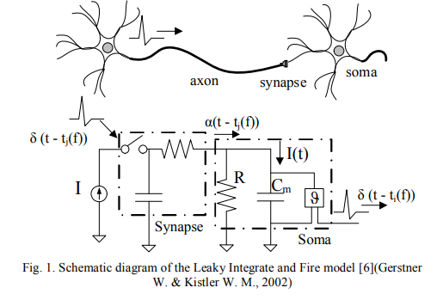
Model
The capacitor is the main storage of the membrane potential of the neuron which is the integration of input current I(t) while the resistor, in parallel with the capacitor, is where the leakage of membrane potential takes place. [Silicon synapse designs for VLSI neuromorphic platform, Nguyen Duc Bui Phong (2015)]

Slide 10


Model
Spikes emitted by the j - th neuron in layer l−1 at a finite set of times {t ^{(k)} _{j} } can be formalized as a spike train S^{(l)} _{j}(t) defined as
The input current I^{(l)}_{i} is obtained from the spike trains of all presynaptic neurons j connected to neuron
τ_{s} is the synaptic time constant.

Slide 11
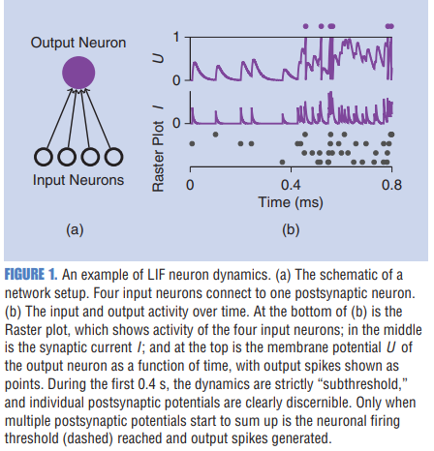
Model
A LIF neuron is fully defined by six parameters τ_{m}, τ_{s}, [U_{th}, U₀, U_{r} ] (bias terms), t_{ref} plus its synaptic weights W^{(l)}_{ij} and V^{(l)}_{ij} .

Slide 12



Model - Neural and synaptic discretization
Membrane potential update that crossed the threshold may result in U^{(l)} _{i} >U_{th} and then the resetting mechanism will not set the membrane potential to U_{r}. However, it was found that this has a negligible effect in simulations

Slide 13

Surrogate Gradient Descent Training
The all-or-nothing behavior of the binary spiking nonlinearity stops gradients from “flowing” and makes LIF neurons unsuitable for gradient-based optimization.
In the forward pass the network follows a step function, in the backwards pass it follows a sigmoidal function, with steepness set by ρ

Slide 14
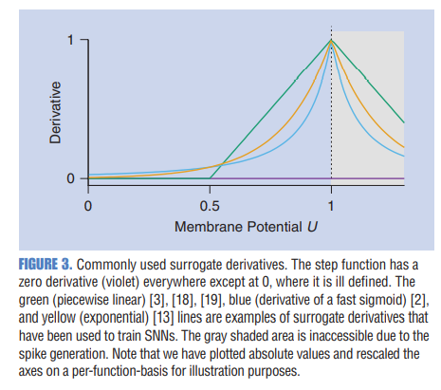
Surrogate Gradient Descent Training
SG constitutes a continuous relaxation of the non-smooth spiking nonlinearity for purposes of numerical optimization. [Neftci et al , 14]

Slide 15

Restrictions on parameters
For α, β (which is indirectly used to calculate τ_{s} , τ_{m}) the clip function to keep it between 3Δt (arbitrarily small time constants which would not have any meaning given a finite time resolution ∆t) and 1 (current and membrane potential would grow exponentially).
α, β are also known as “forgetting factors”, which give lesser exponential value to older samples.

Slide 16
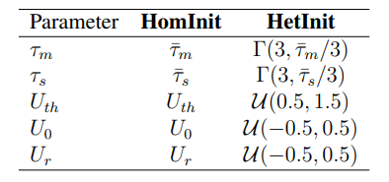
Initialization of parameters
All states I_{i}^{(l)}[0] and U_{i}^{(l)}[0] are initialized to 0. For the weights W and V , we independently sampled from a uniform distribution U(−k ^{−1/2} , k^{−1/2} ), with k being the number of afferent connections.

Slide 17
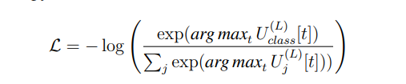
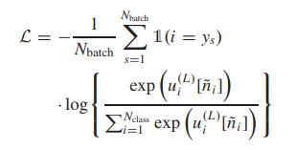
LOSs function
Cross entropy loss formula (max-over-time) where class corresponds to the readout neuron index of the correct label for a given sample. The loss is computed as the average of N_{batch} training samples. This was repeated for a total of N_{epochs}
https://github.com/fzenke/spytorch

Slide 18
Generalization
In order to improve generalization, noise was added to the input by adding spikes following a Poisson process with rate 1.2 Hz and deleting spikes with probability 0.001

Slide 19
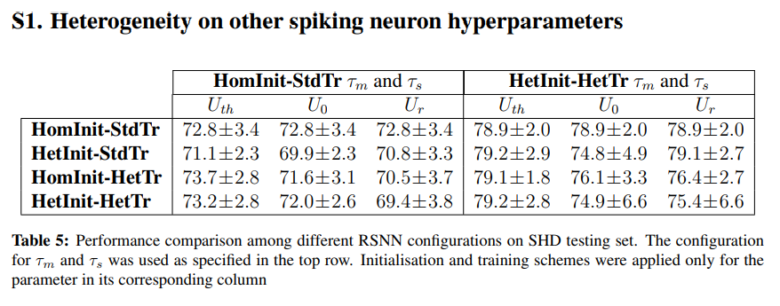
Model

Slide 20
Force training

Slide 21

Model
The FORCE method is used to train a network consisting of a single recurrent layer of LIF.
There are no feedforward weights and only the recurrent weights V are trained.
The first term remains static during training and it is initialized to set the network into chaotic spiking. φ^{T} ∈R ^{K×N} are the weights, updated using RLS (Recursive Least Square). η ∈ R ^{N×K} acts as a decoder and is static during learning (defines the tuning preferences of the neurons to the learned feedback term).
The constants G and Q govern the ratio between chaotic and learned weights.

Slide 22
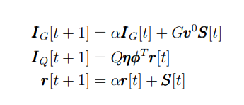


Model
I[t] = I_{G}[t]+I_{Q}[t]
In order to stabilize the network dynamics, a High Dimensional Temporal Signal (HDTS) is added.
Given the HDTS period T, we split the interval [0, T] into M subintervals, I_{m}

Slide 23
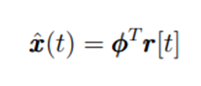
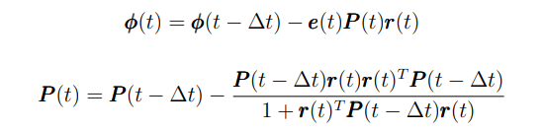

Weight updation - RLS
The aim of FORCE learning is to approximate a K-dimensional time varying teaching signal x[t]. The vector r[t] is used to obtain an approximant of the desired signal. The goal of RLS is to minimize the squared error between the network dynamics x(t) and the target dynamics (i.e., the task, x(t))

Slide 24
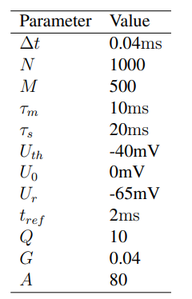
initialization
The period T was chosen to be equal to length of the teaching signal x[t].
The membrane potential were randomly initialized following a uniform distribution U(U_{r}, U_{th}).
Vectors η and µ are randomly drawn from U(−1, 1). The static weights v⁰ are drawn from a normal distribution N (0, 1/(Np² )), then these weights are set to 0 with probability p= 0.1

